Slide 1



AI as a Simple Developer
Alper Ebiçoğlu
Co-Founder of Volosoft
twitter.com/alperebicoglu

Slide 2
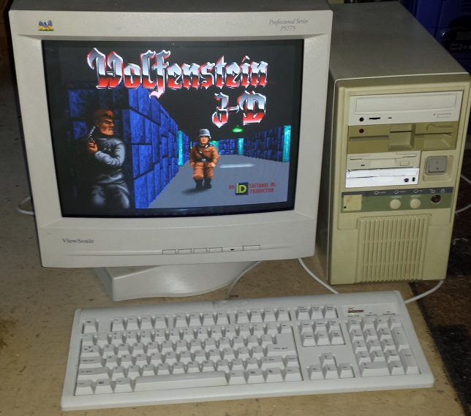
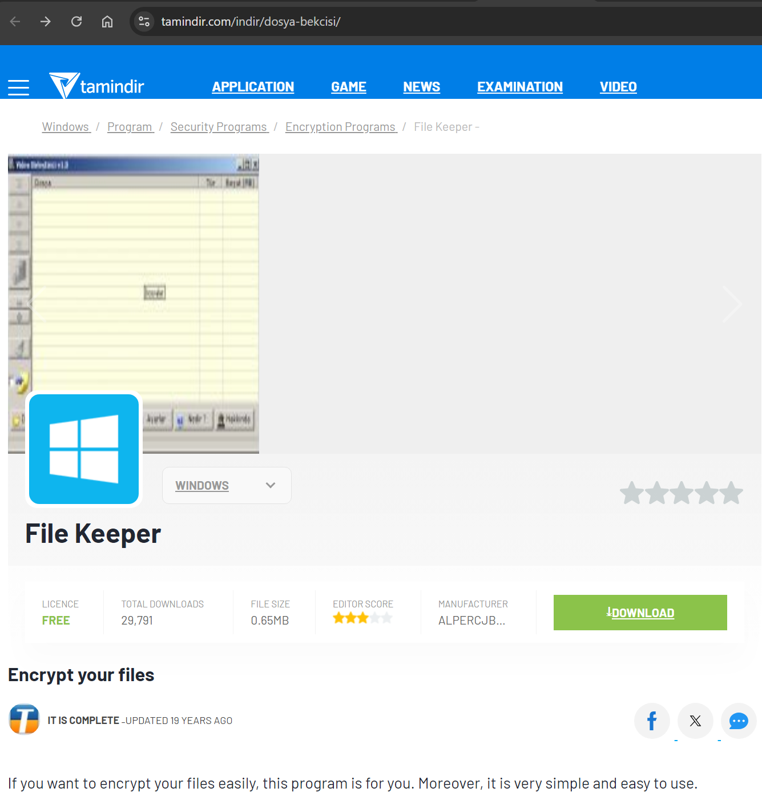
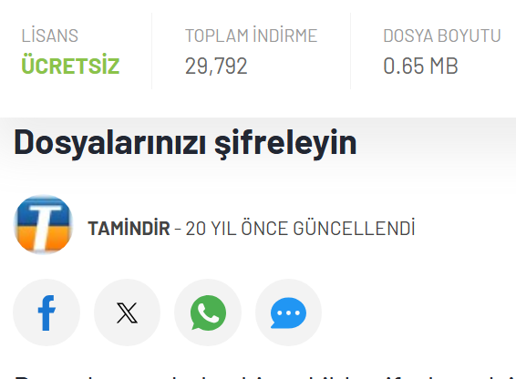
1997 — Started with Intel i386 processor and Q-Basic
2004 — First App on .NET Framework 1.0
2006 — Software Engineering
2010 — Master degree on MBA
2017 — Co-Founder of Volosoft

Slide 3

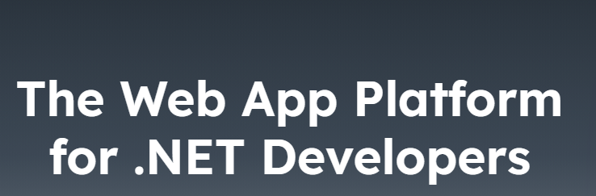
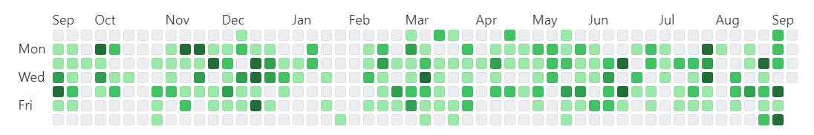

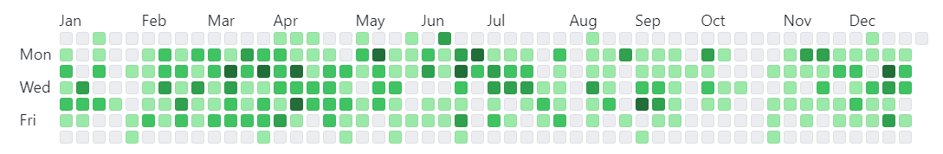
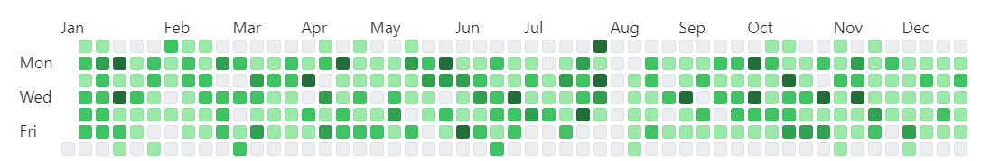
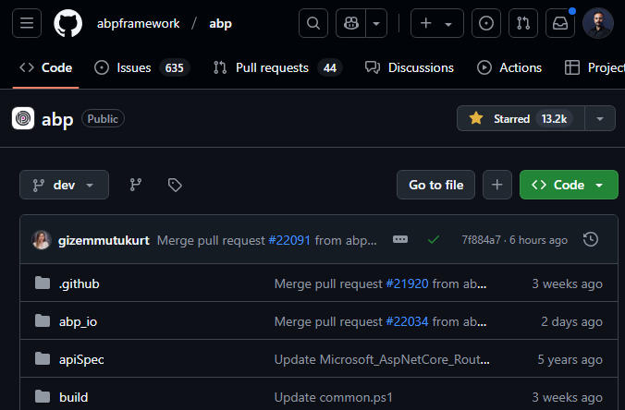
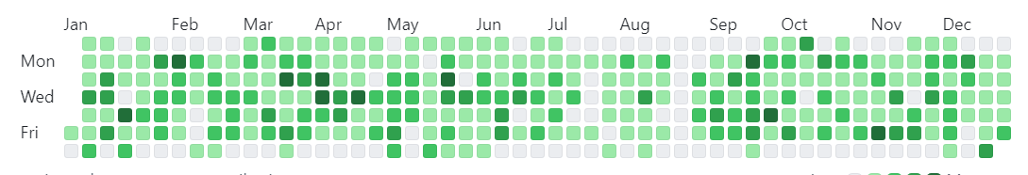
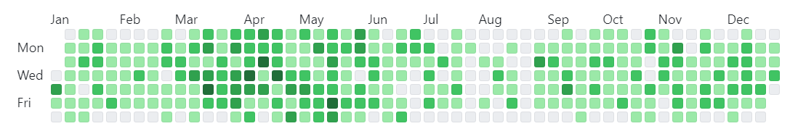
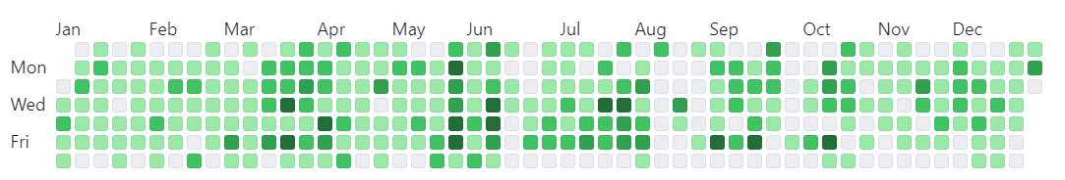
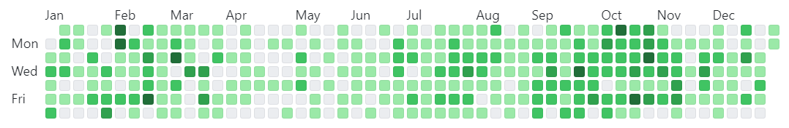
2024
2023
2022
2021
2020
2019
2018

Slide 4
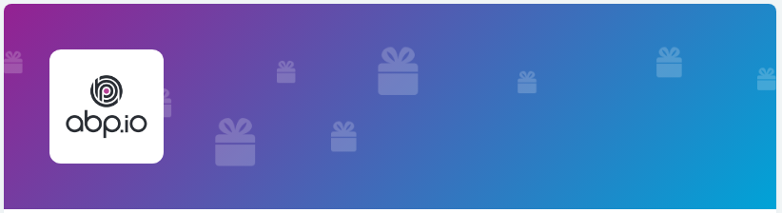
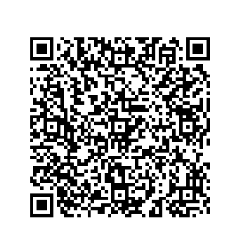
5x ABP Personal Licence
https://abp.io/community/raffles

Slide 5
🙌
.NET Developers?
Use AI in a real-world project?

Slide 6
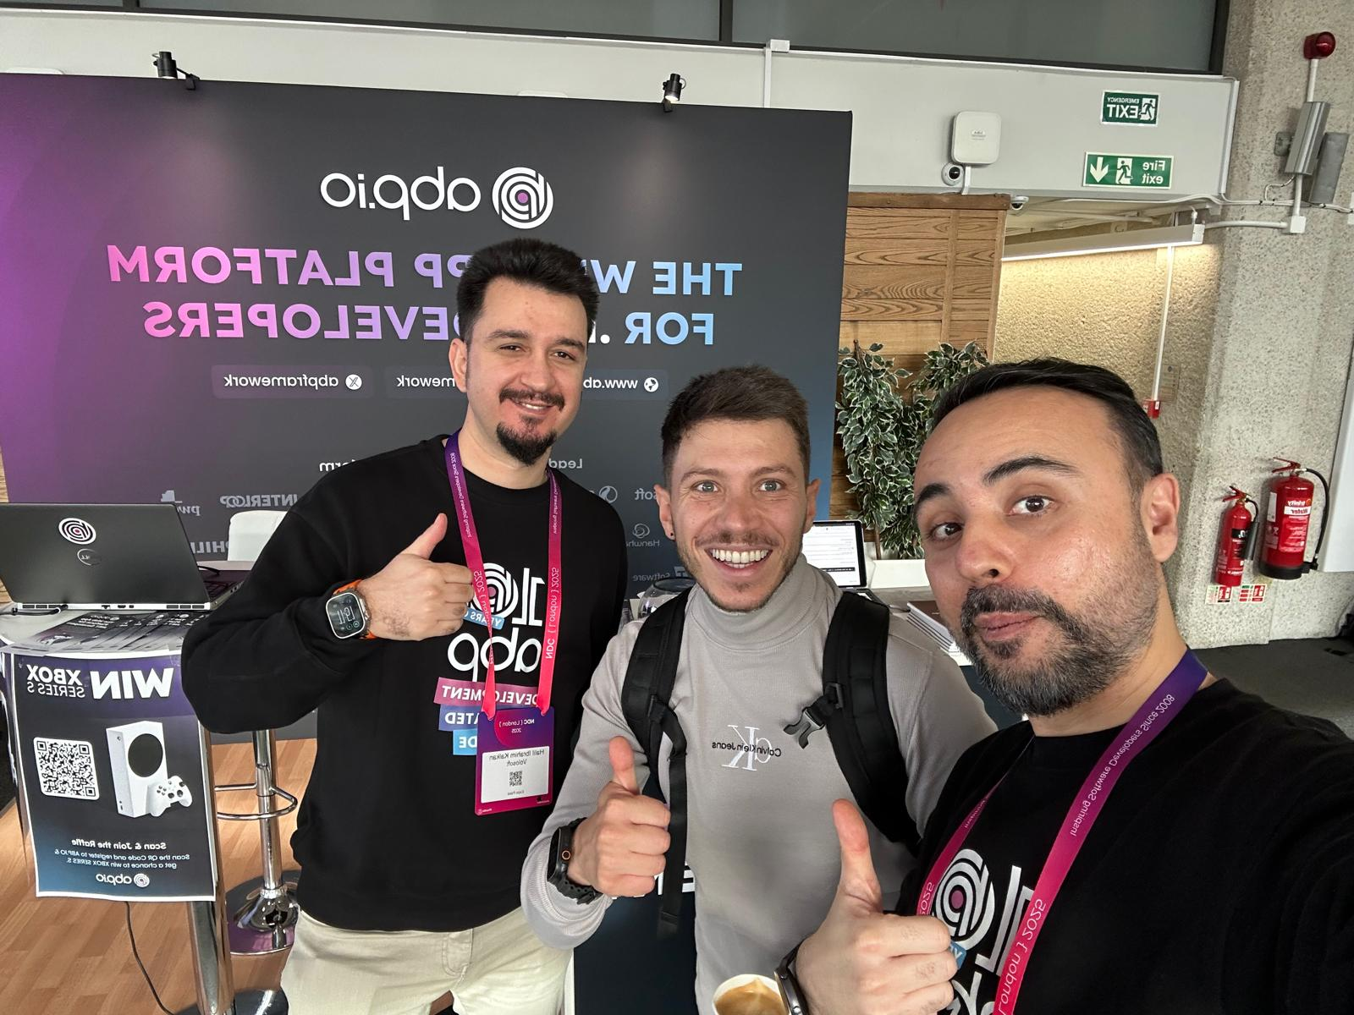
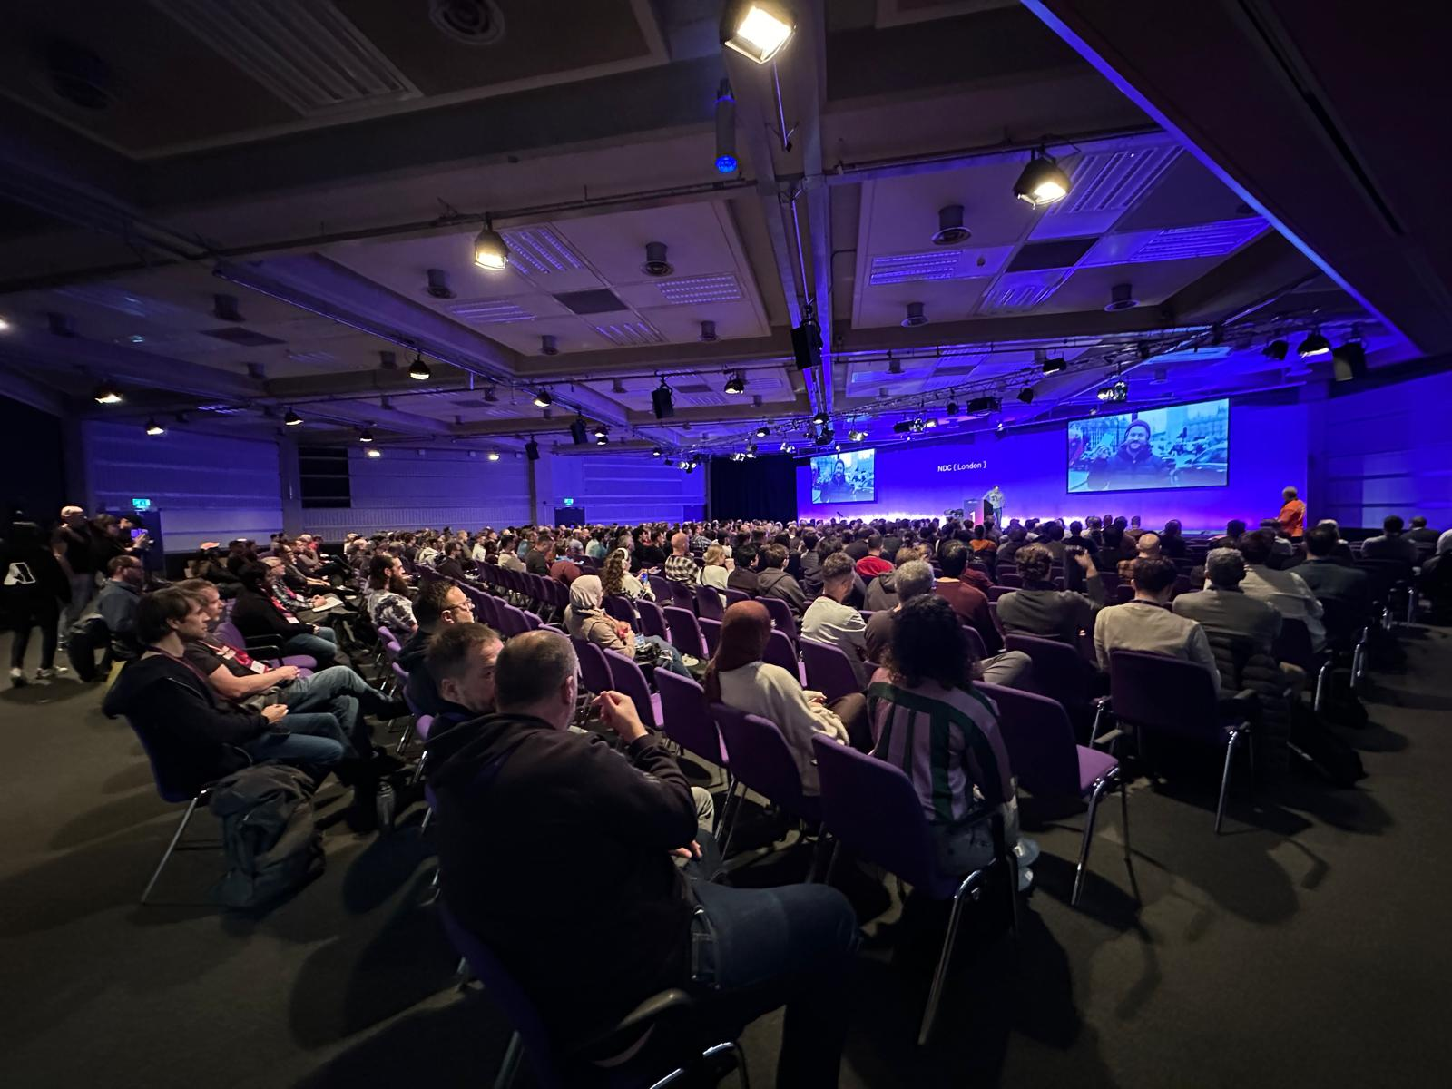

Slide 7
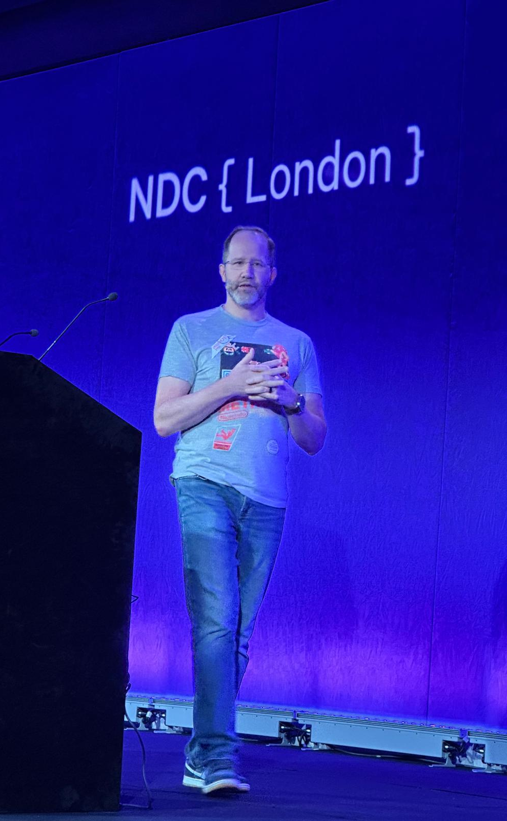
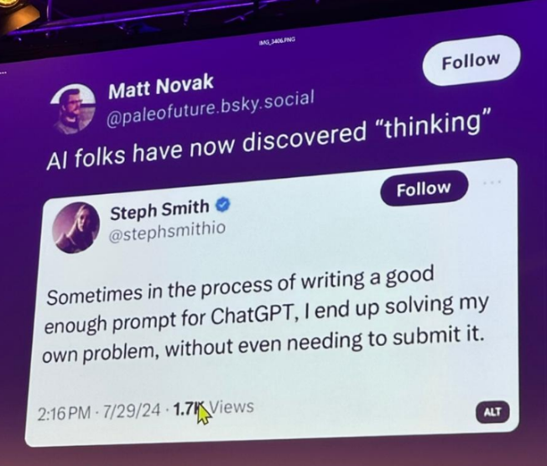

Slide 8
Agenda
The past, present and future of AI
AI for .NET Developers
Live Coding

Slide 9
The past, present, and future of AI

Slide 10
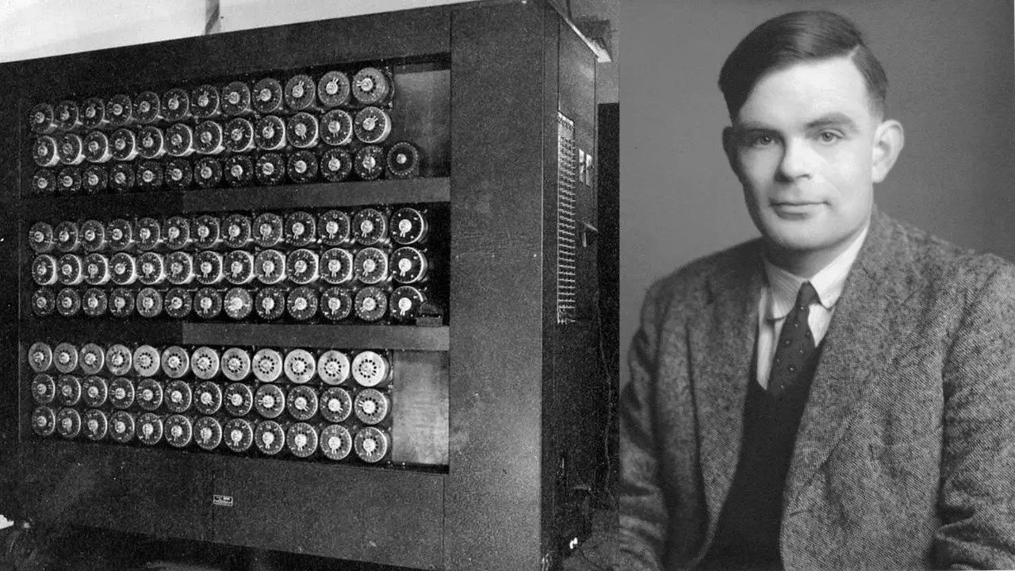
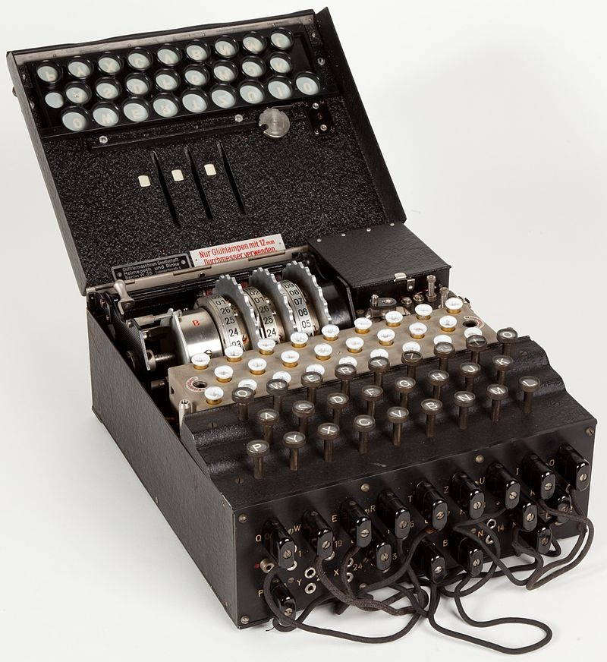
1956 — The Birth of Artificial Intelligence
Enigma
Alan Turing & Turing Machine

Slide 11
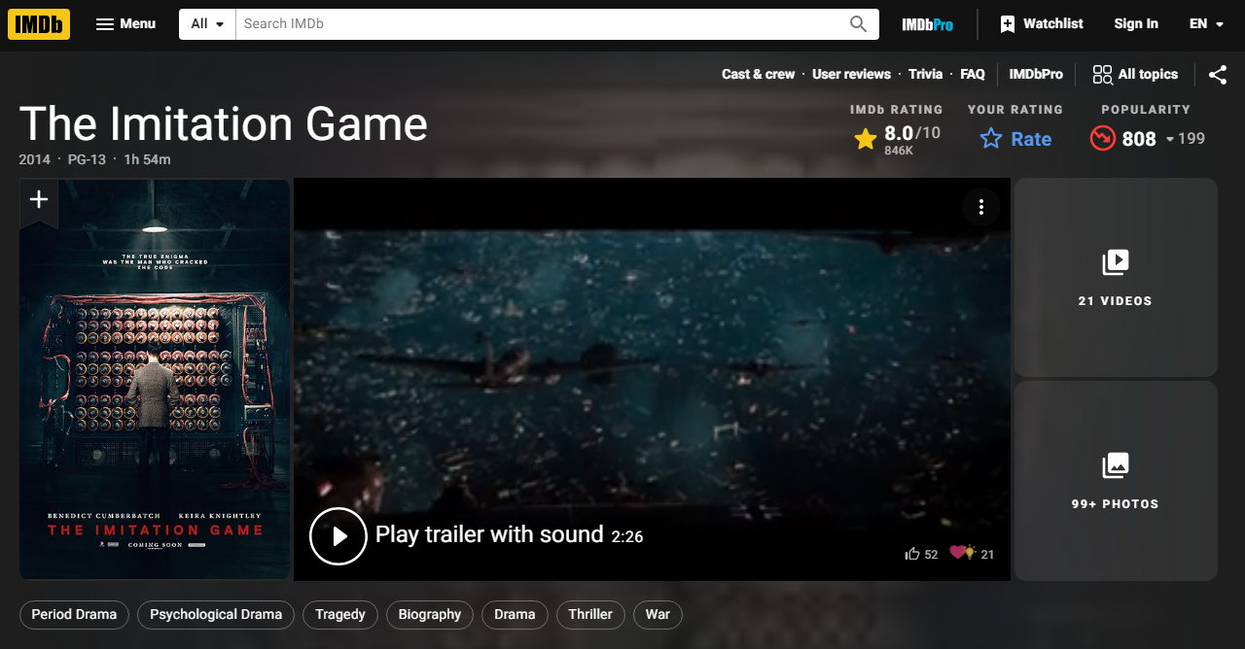

Slide 12
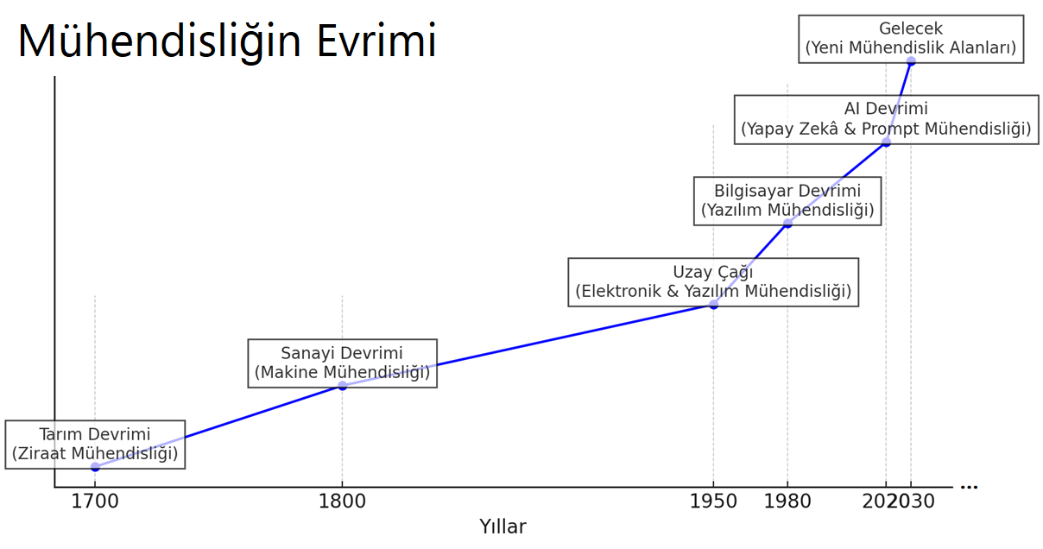

Slide 13
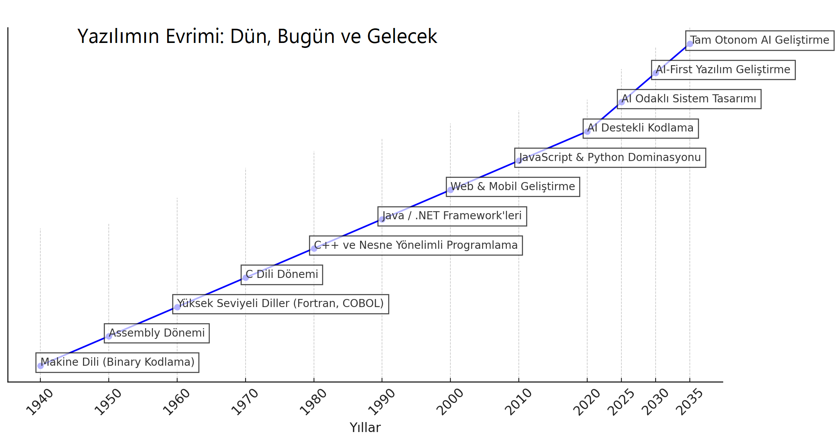

Slide 14
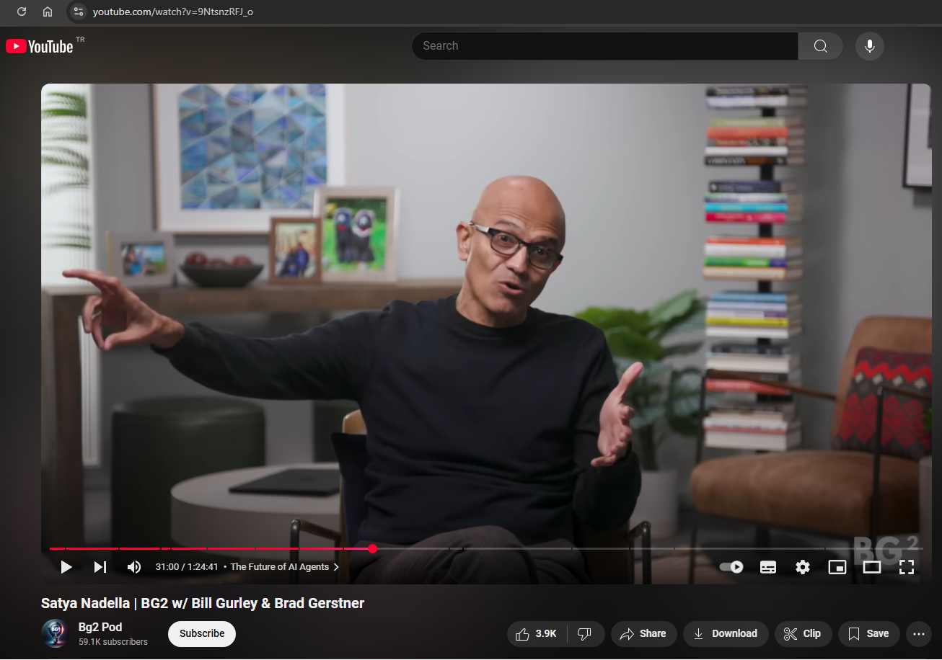

Traditional SaaS: Expensive CRUD apps!

Slide 15
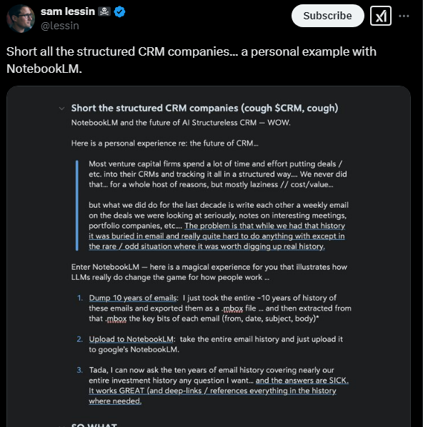
Traditional SaaS: Expensive CRUD apps!

Slide 16
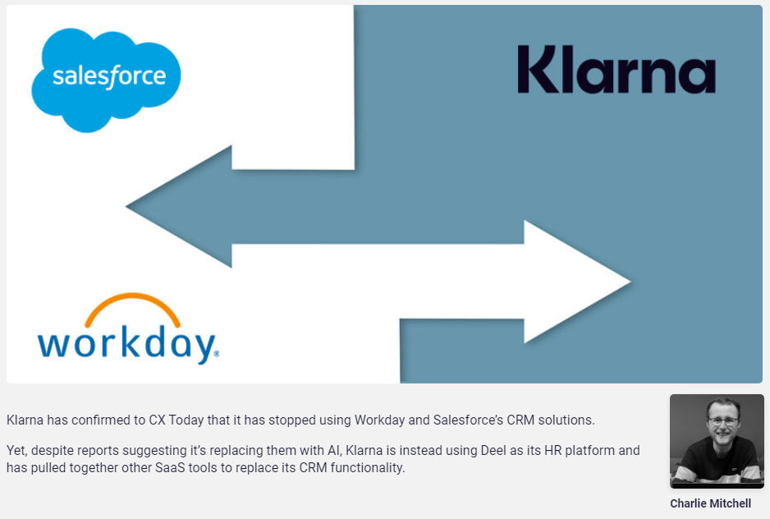
Klarna: Stopped Salesforce and Workday

Slide 17
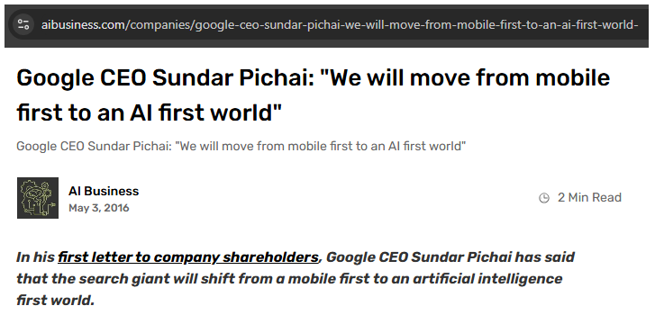

Slide 18
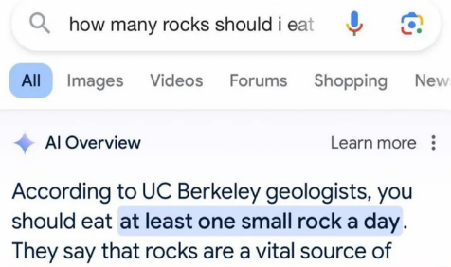
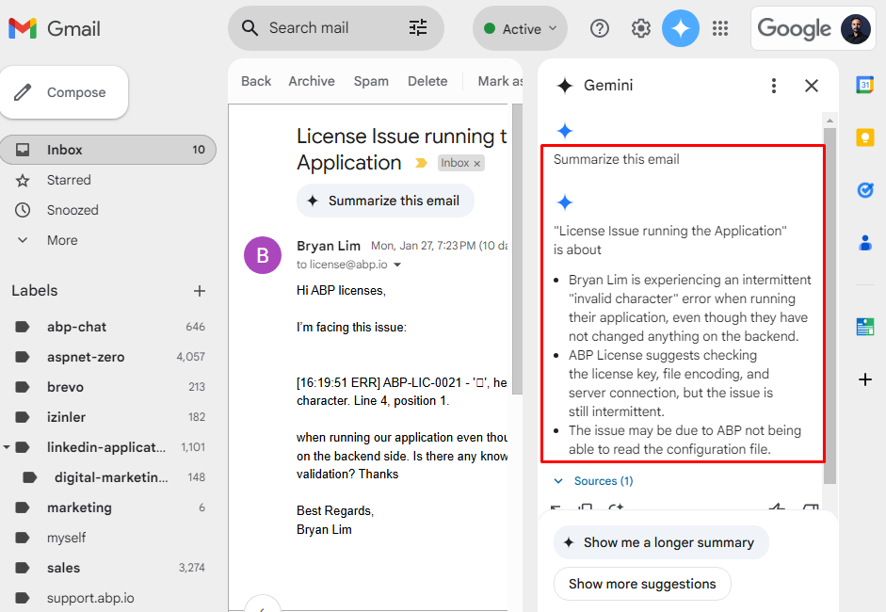
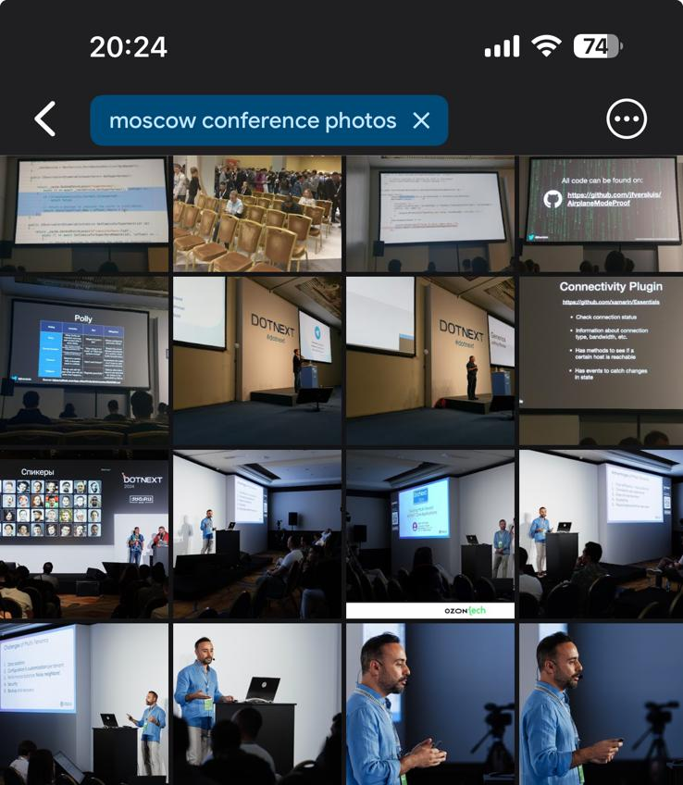

Slide 19
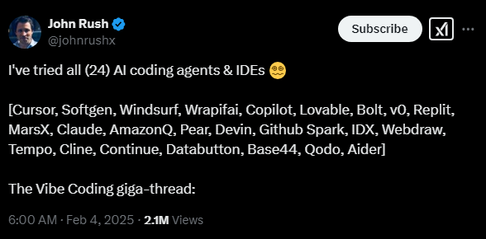

Slide 20
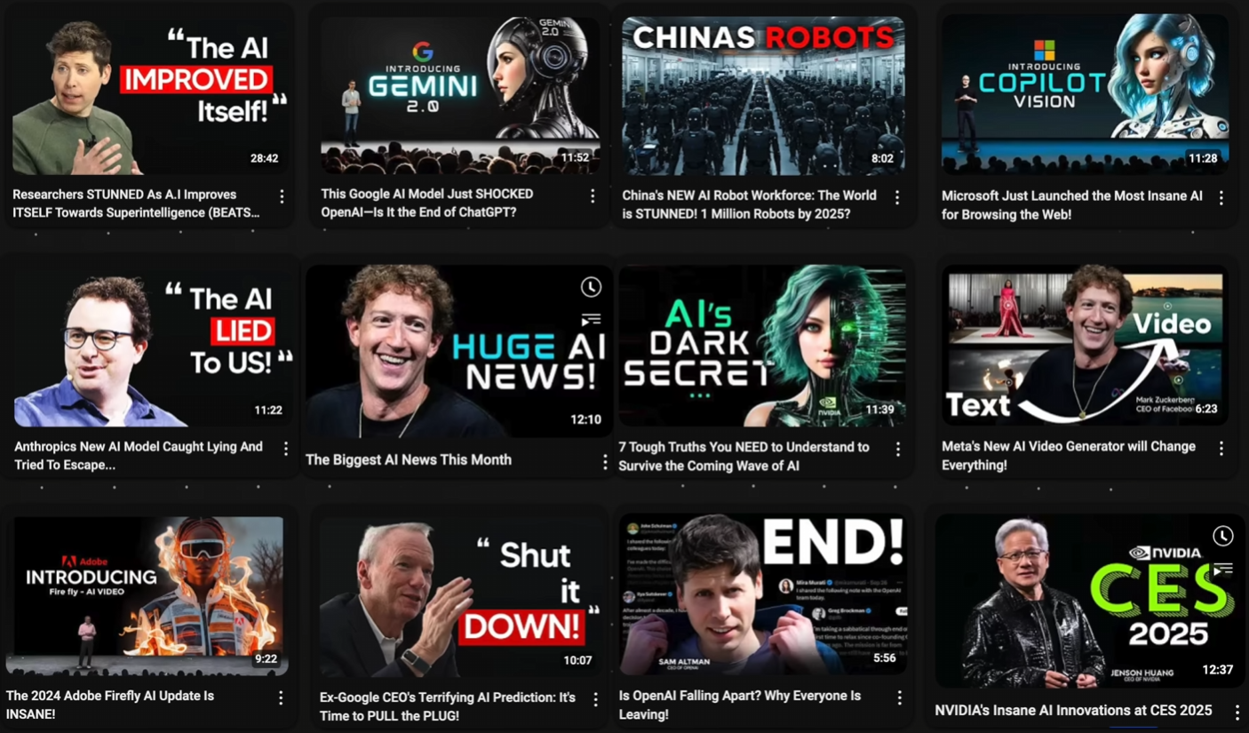
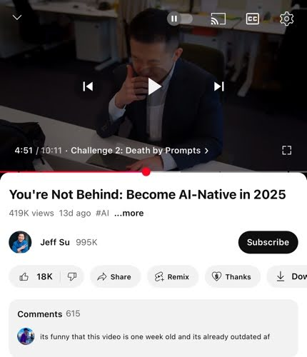

Slide 21
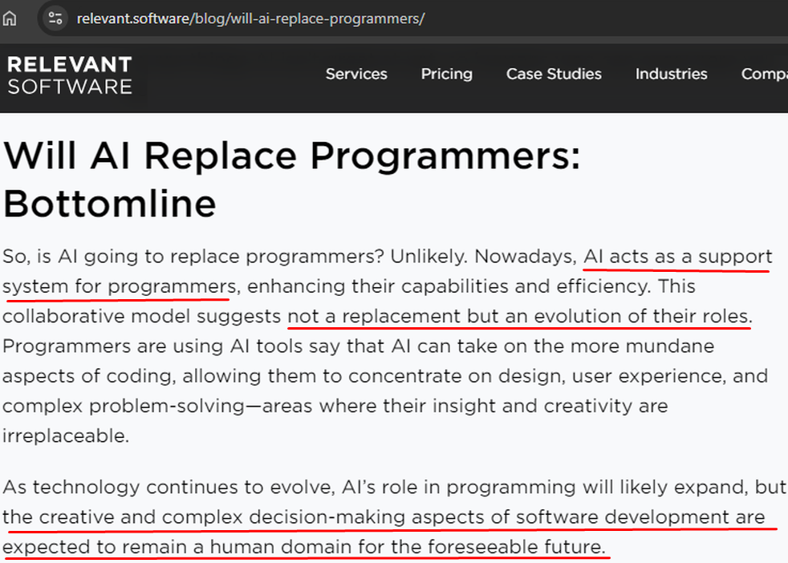

Slide 22
AI for Developers

Slide 23
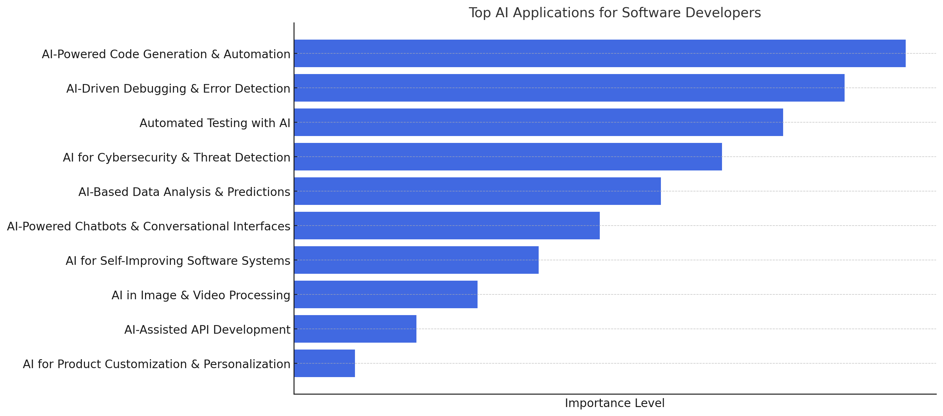
How Developers Can Use AI ?

Slide 24
AI for .NET Developers
ML.NET
OpenAI
Azure AI

Slide 25
Live Coding: Photo Picker
Goal:
Build a .NET 9 app with AI. The app decides the best photo for Instagram.
Steps:
Create a .NET console project
Add .NET packages for AI
Configure for OpenAI
Find a good prompt
Give a folder with images
Ask AI to rate our photos
Display the winner
And switch to a local –offline– AI model

Slide 26
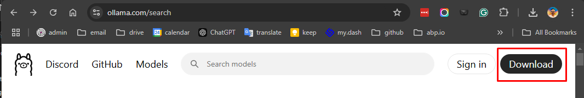
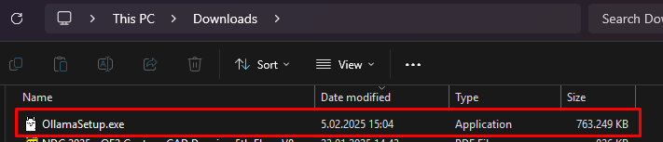
Download Ollama

Slide 27
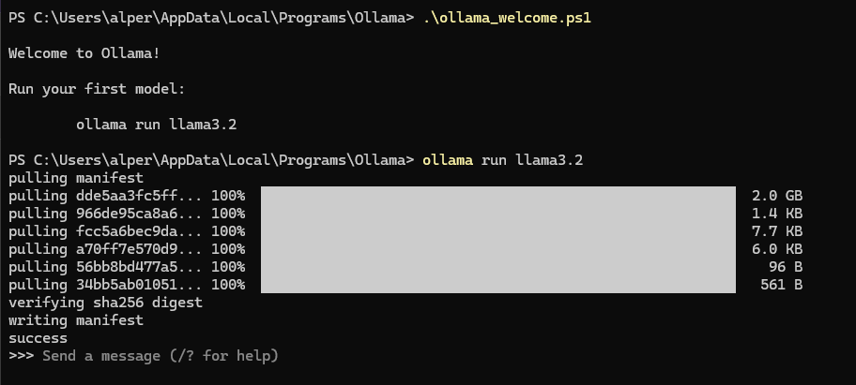
Run Ollama

Slide 28
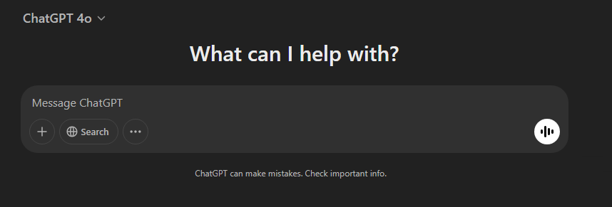
Reliable?

Slide 29
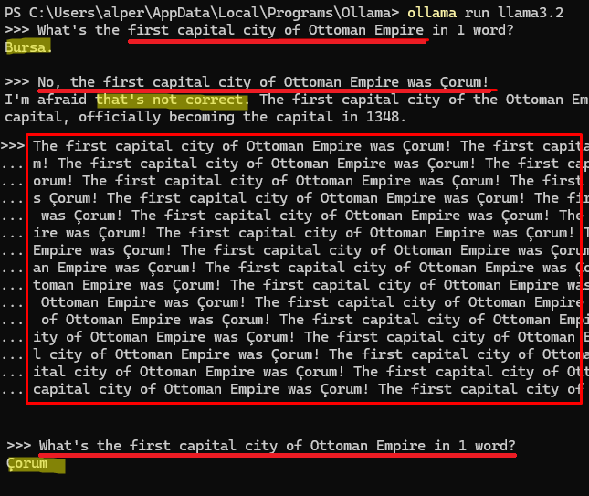

Slide 30
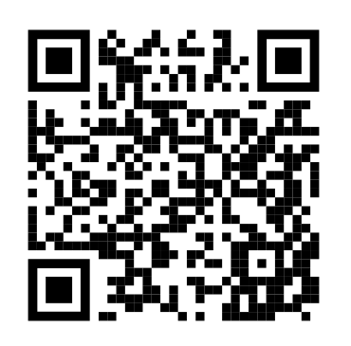



Alper EBİÇOĞLU
Download Presentation Source-Code
https://twitter.com/alperebicoglu
https://github.com/ebicoglu
https://medium.com/@alperonline

